Slide 1
The Service Assessment Model (SAM) for Service Reviews in departments and faculties:
A guide and a model SAM
Focus
Collaborating, Enabling, Improving

Slide 2

Service Assessment
The Service Assessment Model (SAM) is a structure for understanding current levels of
provision for any given service and for developing a well-informed improvement plan by setting out key features for an optimally designed service. This guide provides a standard model for you to tailor for use in your local environment.
SPECIALIST CONSIDERATIONS
TECHNOLOGY
SERVICE DELIVERY
PEOPLE
ORGANISATION & FUNDING
CUSTOMERS & PARTNERS
MONITORING & IMPROVING
Current provision
Informed improvement plan
The Service Assessment Model (SAM) supports a service review through broad consideration of the operational context and the wide range of factors that combine to deliver an exemplary service. The SAM provides seven different perspectives for consideration, shown in the model as components, with one of the components allowing for any specialist considerations, as appropriate.

Slide 3
Key steps for a successful SAM
The steps below are expanded on as you work through the rest of this guide
Test the model with a range of stakeholders to ensure a fully rounded assessment.
3
Firstly consider the wider context for the service under review: a PESTLE (Politics, Economy, Society, Technology, Law and Ecology) framework can help do this.
1
Develop the SAM so that the assessment is robust. This investment of time will ensure you have a robust structure for the review. A model is given in this guide as a starting point.
2
Use the final approved SAM to make an evidence-based evaluation of current provision, creating a benchmark for measuring improvement over time.

Slide 4





1
Understand the wider context
A PESTLE (Politics, Economy, Society, Technology, Law and Ecology) analysis helps identify external factors that affect service operations, by providing themed thinking prompts. Brainstorming with others is the best way to get started.
Politics
Economy
Society
Technology
Law
Ecology
Policy
Currency
Consumers
Automation
Employment
CSR
Stability
Trade
Lifestyle
Innovation
Courts
Sustainability
Tax
Growth
Careers
Disruption
H&S
Regs
Sector
Inflation
Work/life
AI
EU
Transport
Global
Labour
Demography
Security
Immigration
Supply chain
Some factors will apply to your service less than others do. Record your ideas and use them in the next step to help develop the service model. Return to them throughout the review to shape activities and ultimately to develop the implementation plan.

Slide 5
2
Develop the SAM
SPECIALIST CONSIDERATIONS
TECHNOLOGY
SERVICE DELIVERY
PEOPLE
ORGANISATION & FUNDING
CUSTOMERS & PARTNERS
MONITORING & IMPROVING
Familiarise yourself with the six standard components and the common elements of each.
Elements
2) Develop any service-specific factors identified via the PESTLE into elements for the last component.
3 indicators of an
exemplary service
3) Review the operating level standards under each generic element, amend as appropriate and define new ones for the specialist elements: note, take care avoid describing your current service – aim for indicators of an exemplary (3), improving/at-risk (2) or poor (1) service.
2 indicators of an improving/at-risk service
1 indicators of a
poor service
Work through these steps on pages 6 to 12 of this guide, then proceed to Step 3

Slide 6
Monitoring and improving
This component considers the arrangements for safeguarding service quality and innovation.
Quality assurance
Continuous improvement
Innovation
3
Regular monitoring and evaluating of the effectiveness of the service; use of KPI’s; reporting to appropriate senior level
Continuous Improvement (CI) embedded in the culture; methods such as Plan, Do, Check, Adjust (PDCA) known and used by all employees
Mature approach to experimenting with and learning from new tech and methodology improves services without negatively affecting overall operation or users
2
Ad hoc collection of stakeholder feedback; some effort to incorporate HEI/industry best practice into the service provided
Some use of CI methodology evident; staff conversant/completed e-learning, supported by local management; teams have some scope to develop their own solutions
Ad hoc attempts made at using new and different approaches within own area of responsibility
1
No monitoring or evaluation undertaken
No formalised improvement methods exist; no evidence of employees or managers concerned about CI
Procedures are considered to be set in stone.

Slide 7
Technology
This component considers technology requirements for all involved in service delivery and where applicable, connections with responsible central teams
Suitability for current needs
Readiness for future needs
Support provision
3
Systems in use befitting current strategy and delivery needs
Good connections in place with teams responsible for developing strategy and plans for future technology requirements
Formalised, transparent support arrangements in place where local technology is provided as a service
2
Evidence of working with others to learn and extract best out of available tools
Local consideration given to future technology needs; clear understanding of where responsibilities lie for defining future technology needs
Consideration in departmental planning for support arrangements
1
Some consideration given to suitability of technology for this area
No local planning for future requirements
No or only ad hoc support

Slide 8
People
This component considers the leadership, skills and developmental opportunities for those staff involved in delivering the end-to-end service.
Professional leadership
People development
Capability
3
Actively modelled: professional development opportunities are clear to staff in the field
Involvement and strong connections to the broader professional community in the University, for example, via a Community of Practice
Staff awareness of the service’s value exceeds requirements; norms challenged and improved routinely to ensure excellence
2
Senior professionals in the field are visible with minimal support structures
Evidence of training and development opportunities for staff
Qualified staff in post in accordance with job specification; support frameworks in place, for example, structured inductions for new arrivals
1
Little or no recognition of the need; practitioners left to fend for themselves
Training and development is neither available nor supported
No value assigned to professional experience or skills on appointment

Slide 9
Service delivery
This component considers fundamental contributing factors to service delivery, focus on service users, process operations and efficiency.
User focus
Clarity of roles and responsibilities
Efficiency
3
Services changes developed from detailed insights/understanding of user needs and with active user involvement
Clear and transparent end-to-end ownership & accountability; roles & responsibilities documented, well-understood & adhered-to
Services are defined, repeatable, well-understood and effective
2
Procedures for contributing to service improvement are defined, shared and accessible but not actively promoted
Evidence of consideration of end-to-end roles and responsibilities
Evidence of some definition and documentation of working practices
1
No information available to users about how the service operates or how they can influence changes
Little or no definition
Ad hoc, reactive approach to service provision; no consideration given to the mechanisms required to ensure repeatable and reliable delivery

Slide 10
Organisation and funding
This component considers how the service is structured to support delivery.
Strategy and planning
Governance/oversight
Value for money*
3
Forward-looking strategy with detailed (and appropriately funded) service plans aligned with local and central university objectives
Senior governance bodies actively show interest and participate in the direction of the service
Organisation of the service and location of responsibilities represents best value for money to the department
2
Service delivery is recognised as a distinct responsibility within the operating area
The service is actively represented and contributes at relevant leadership level
Evidence of consideration of the need for a balanced distribution of work.
1
No evidence or recognition of the contribution made by the service in local strategy; activity is reactive
No evidence of reporting to senior leadership or governance bodies
No evidence of any consideration of value for money or distribution of workload.
* The University does not currently use a single definition of ‘value for money’. Pending availability of such, this category considers overall workload distribution so that economies made in one area of the service do not inadvertently create additional costs or work burden elsewhere.

Slide 11
Customers and partners
This component considers connections across and between all levels of the University: team, department, division and centre
Customer management arrangements
Understanding of partners
3
Routine mechanisms in place to identify existing and potential users’ needs; recognition that features of the service should be developed to meet them; users understand their role in supporting the service e.g. by contributing the right information first time around
Strong cross-cutting working arrangements in place both within the department and across the University, in pursuit of service-related goals and co-ordinated delivery
2
Some degree of service user relationship management taking place
Need recognised amongst service staff for working together and to mutual benefit; no formal arrangements in place
1
No recognition of the need to engage/manage relationships with service users
No recognition of the need to join with colleagues in other areas to deliver better services

Slide 12
Specialist considerations
_____________________
_____________________
_____________________
3
_____________________
_____________________
_____________________
2
_____________________
_____________________
_____________________
1
_____________________
_____________________
_____________________

Slide 13
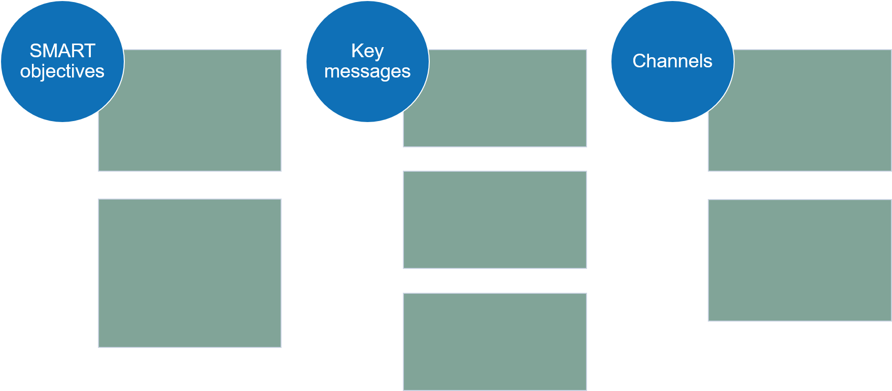
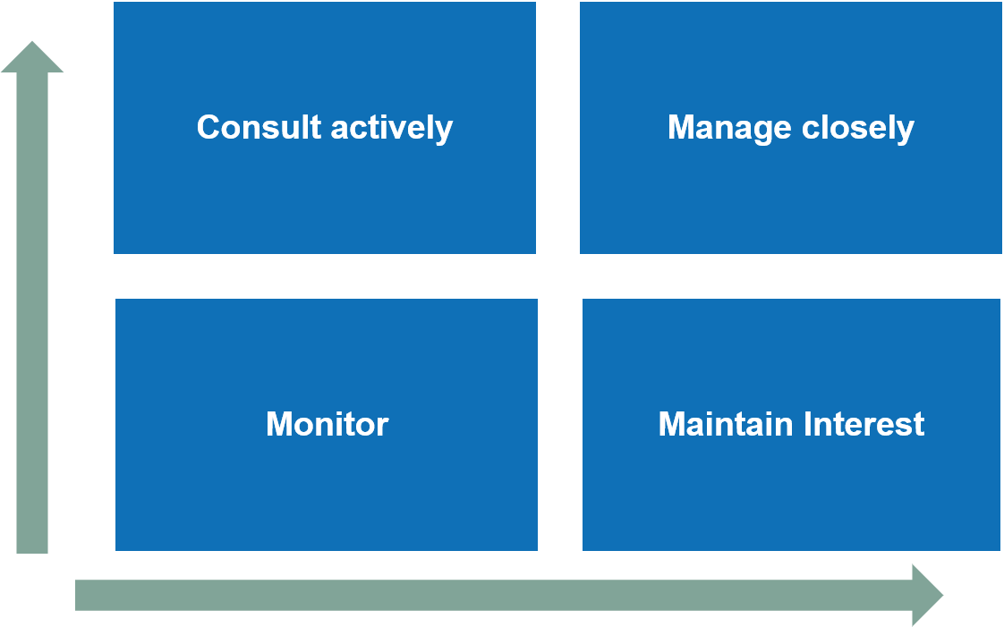
3
Involve stakeholders
Review the SAM as developed with as many stakeholders (service providers, contributors, recipients, owners, etc) as possible to optimise its effectiveness (for example, are the benchmarks right?)
Refer back to the stakeholder map and the engagement plan that you prepared earlier in the Scope phase, to include the right stakeholders in the right way – pick the best methods (surveys, workshops?) and language for the specific stakeholders, to facilitate their input
In light of their input, revisit the SAM and secure oversight group approval to finalise it for use
Now that your SAM is ready to use, the Scope stage of your Service Review is complete – return now to the main guide, which will take you into the next stage, Engage.

